Slide 1
AeroLens
Air Quality Monitoring System
Jana Godieh 0223457
Dana Abu Al-Ruz 0224982
Leen Al-Masarweh 0222209

Slide 2
The Problem
The Solution
Silent risks like gas leaks and fires.
Lack of remote warnings when the user is away.
A smart system powered by ESP32 with "Traffic Light" logic.
IoT Integration: Real-time data on ThingSpeak.
Smart Alerts: Sends an immediate Email Notification in case of danger.

Slide 3
Hardware

Slide 4
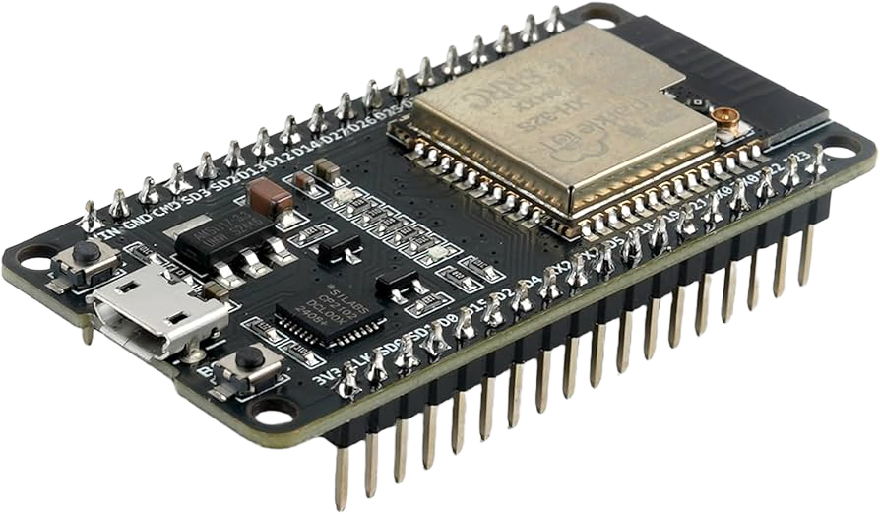
ESP32 Controller

Slide 5
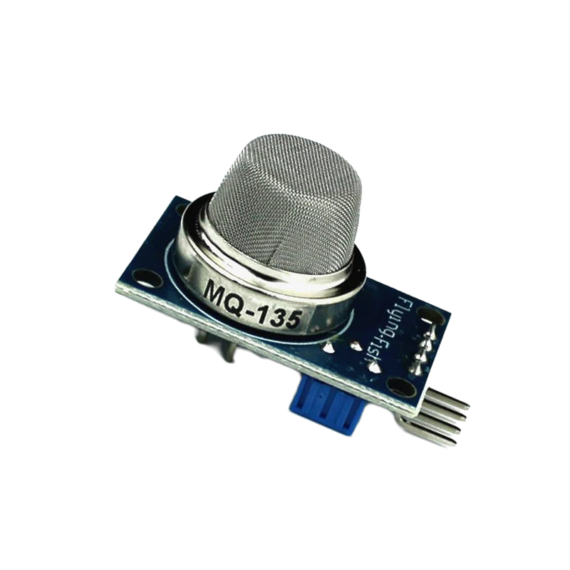
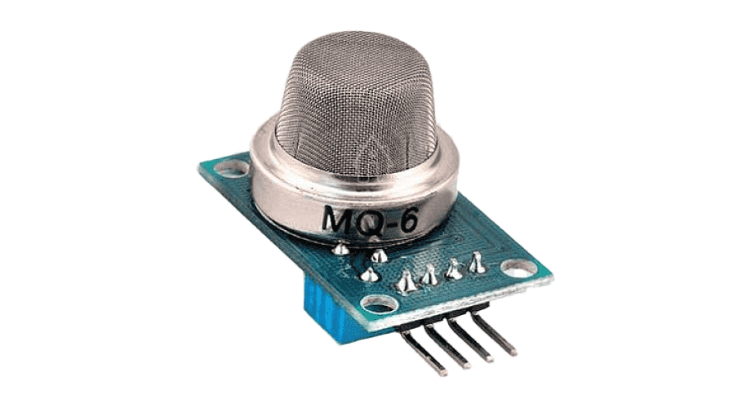
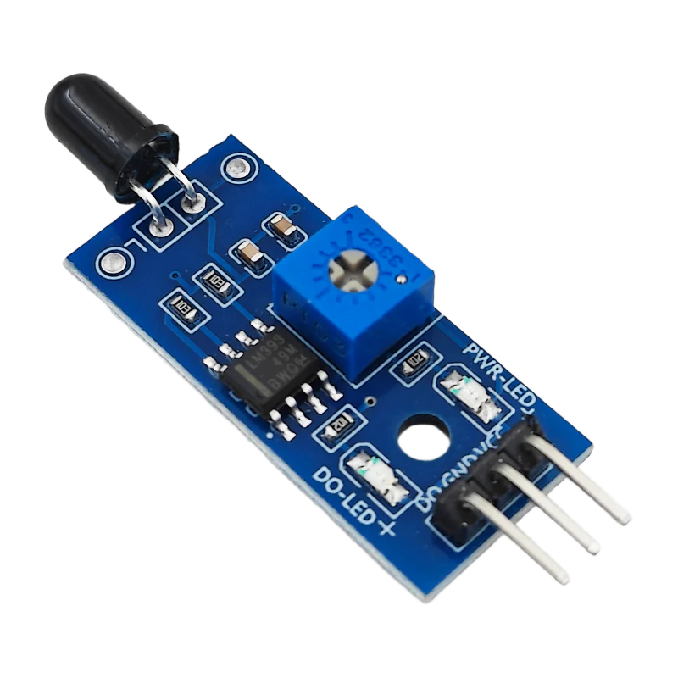
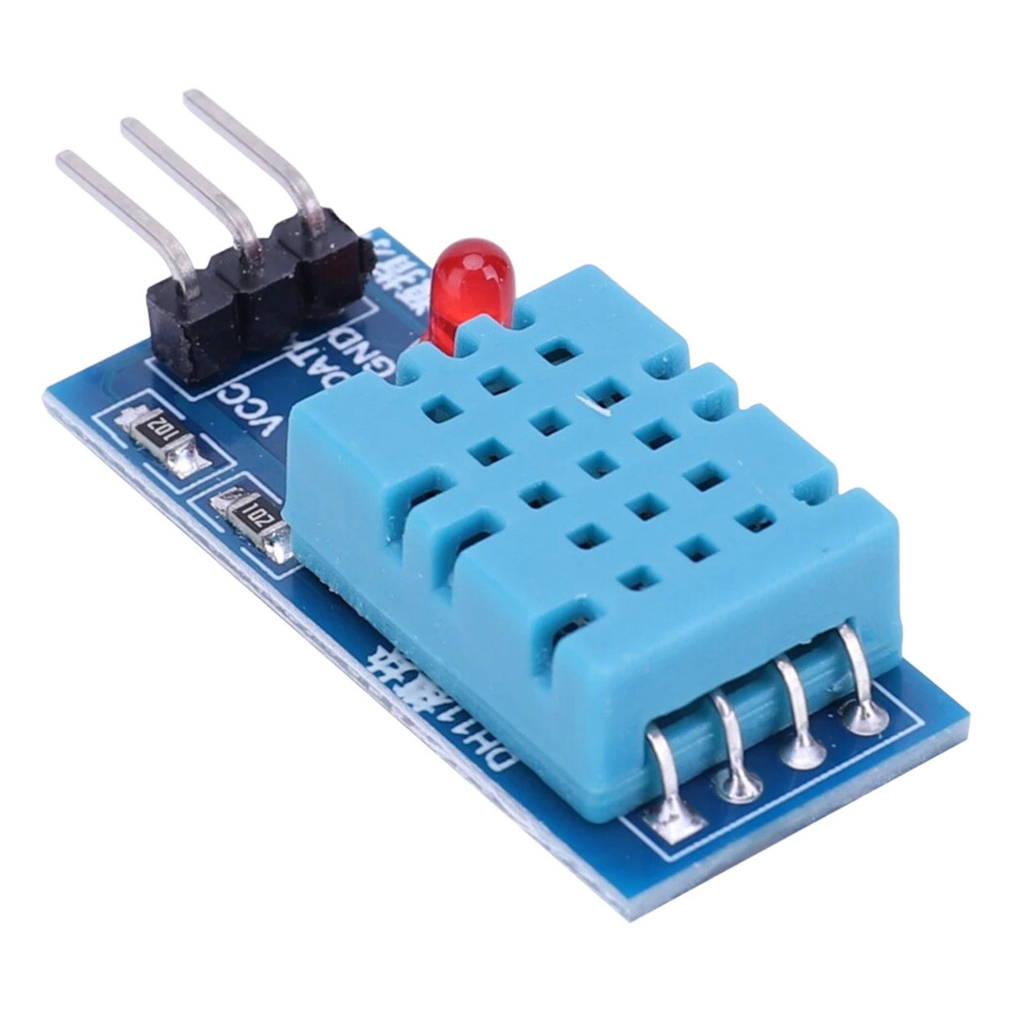
Sensors

Slide 6
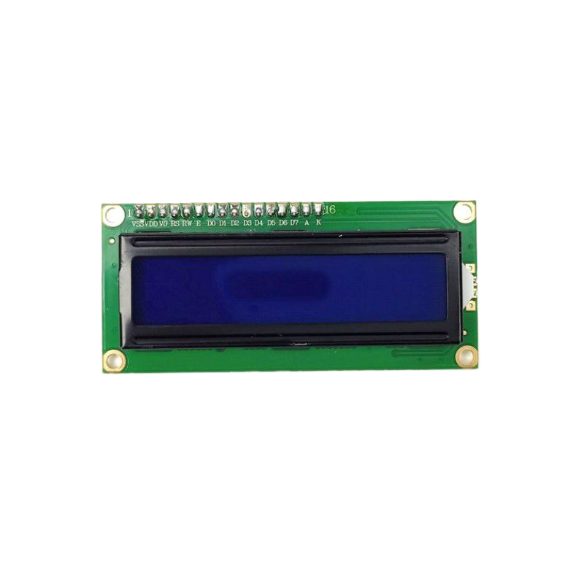
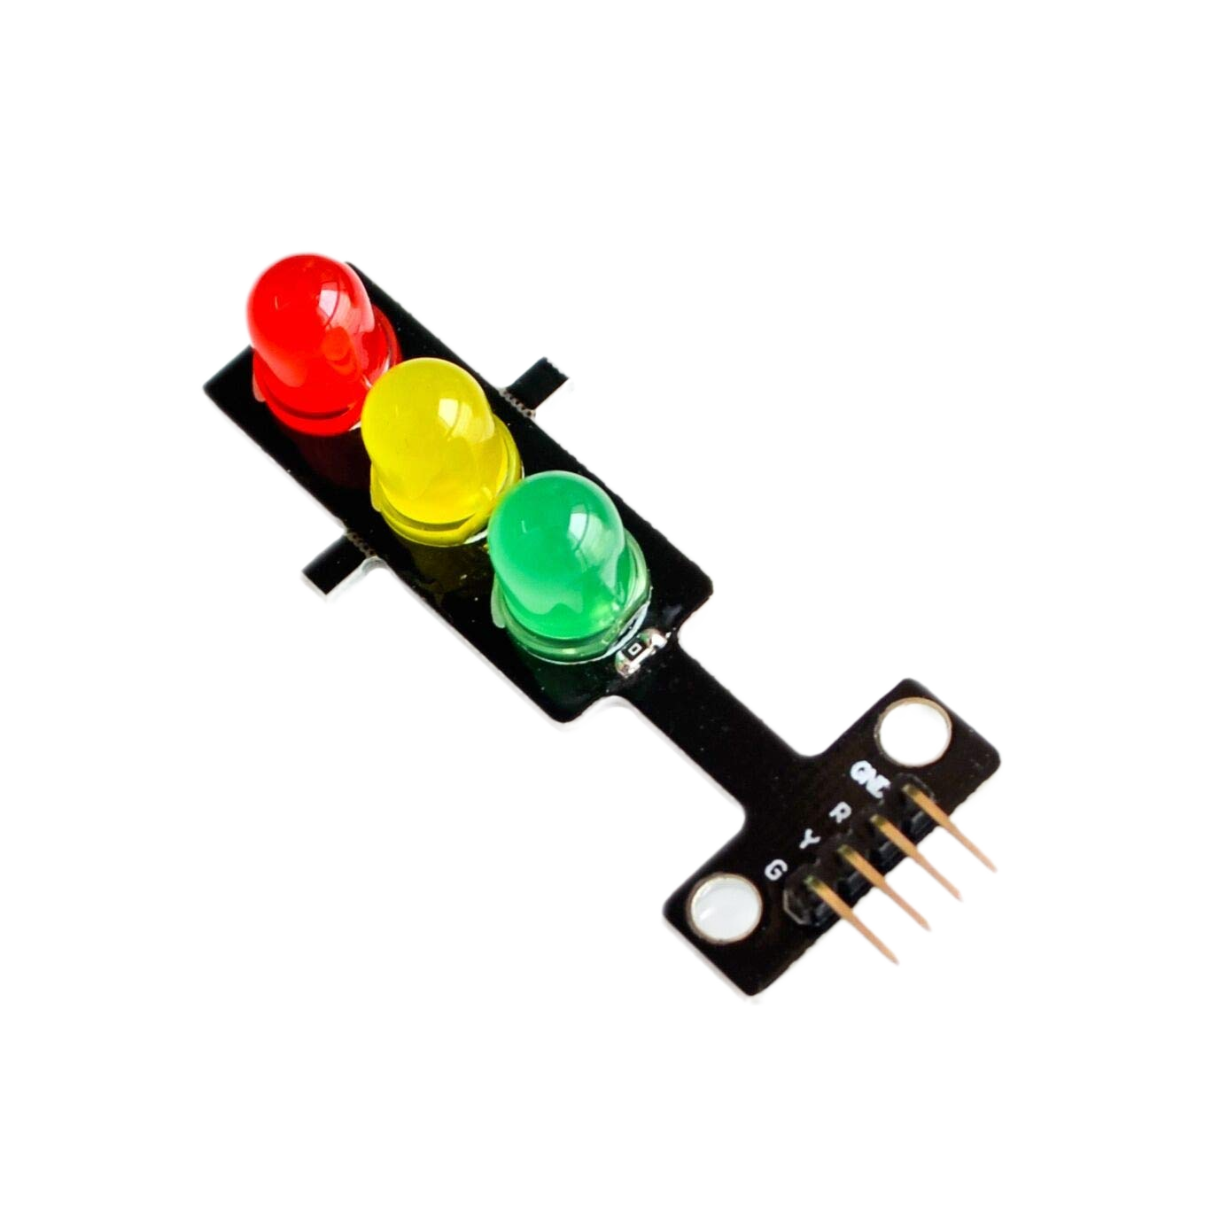
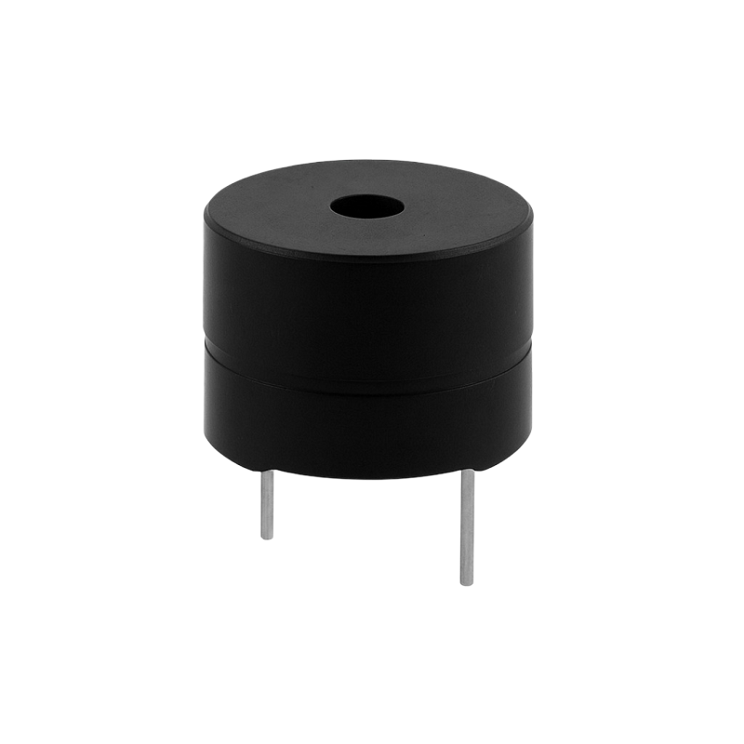
Outputs

Slide 7
Component | ESP32 GPIO Pin | Type
MQ-6 Sensor | GPIO 34 | Analog Input
MQ-135 Sensor | GPIO 35 | Analog Input
Flame Sensor | GPIO 14 | Digital Input
DHT11 Sensor | GPIO 4 | Digital Data
LCD (SDA) | GPIO 21 | I2C Data
LCD (SCL) | GPIO 22 | I2C Clock
Green LED | GPIO 25 | Output
Yellow LED | GPIO 26 | Output
Red LED | GPIO 27 | Output
Buzzer | GPIO 32 | Output

Slide 8
Software & Simulation Tools
01
02
Wokwi Simulator
ThingSpeak IoT
For circuit design and testing.
For cloud data visualization.

Slide 9
System Logic & Workflow
Sense
Data Smoothing
Sensors collect data (Gas, Fire, Temp)
It calculates the average of multiple readings to ensure stability.

Slide 10
System Logic & Workflow
Process
ESP32 analyzes risk levels
Level 0 (Green): Normal range.
Level 1 (Yellow): Slight gas increase
Level 2 (Red): High gas, Fire detected, or Temp > 50°C

Slide 11
System Logic & Workflow
Local Act
Cloud Upload
Notification
Buzzer alarms and Red LED turns on.
Data sent to ThingSpeak
System triggers an Email Alert to the user: "Danger! Fire Detected" or "Gas Leak Detected".

Slide 12
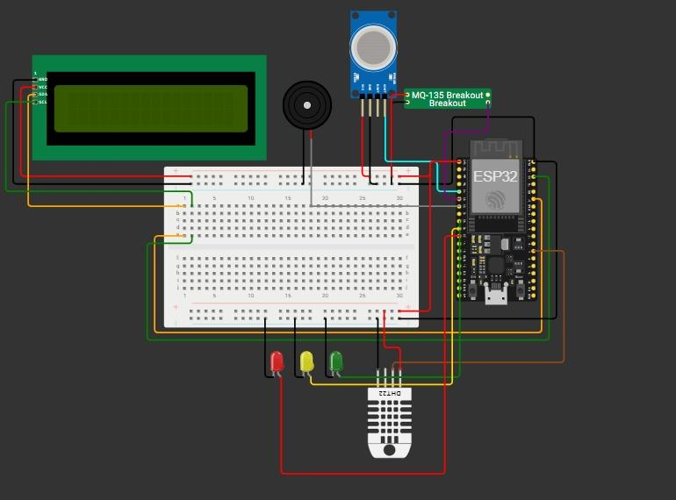
Circuit Diagram (Wokwi)

Slide 13
IoT Data Visualization (ThingSpeak)
Real-time Graphs
Alert Log
Shows Temperature and Gas levels.
Records the time when Email Alerts were sent.

Slide 14
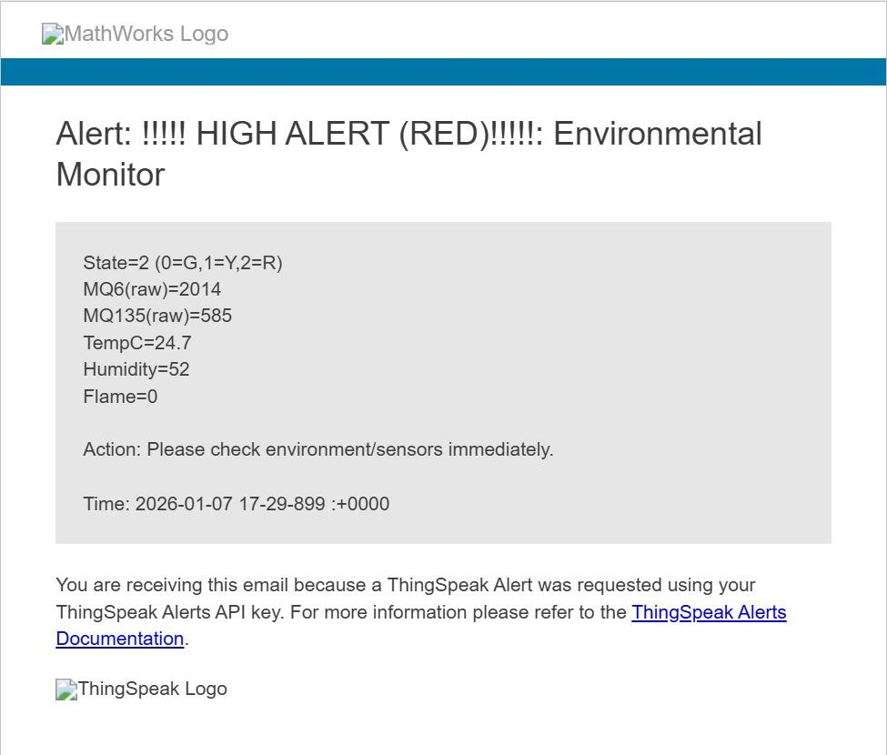

Slide 15
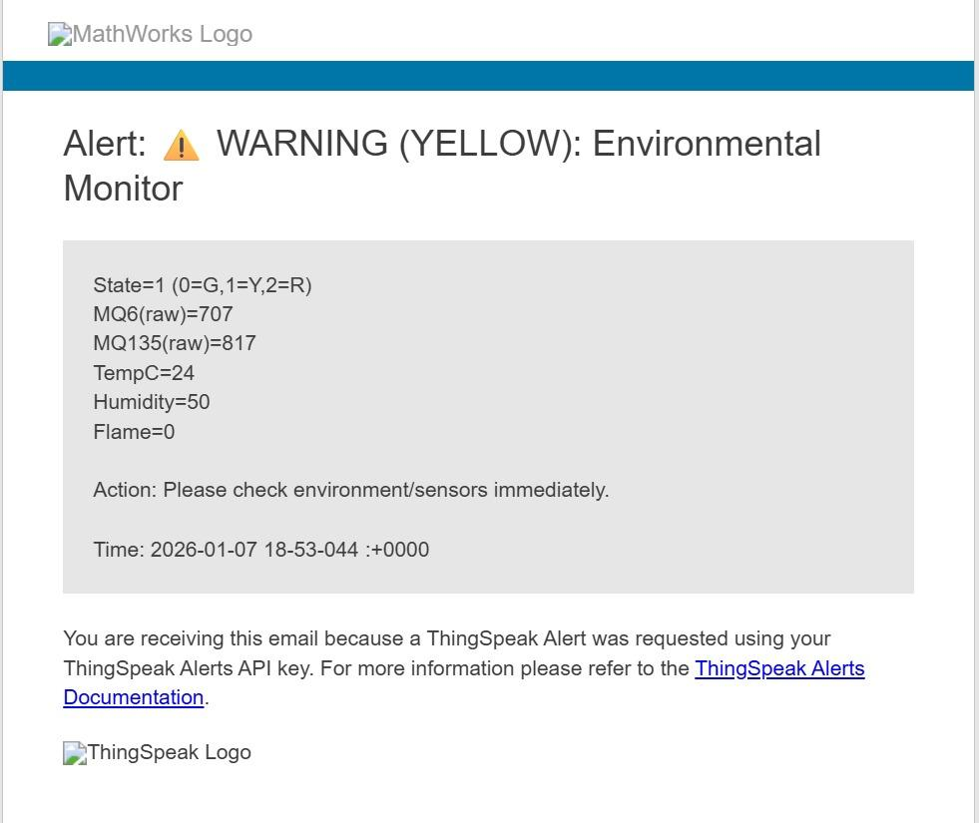

Slide 16
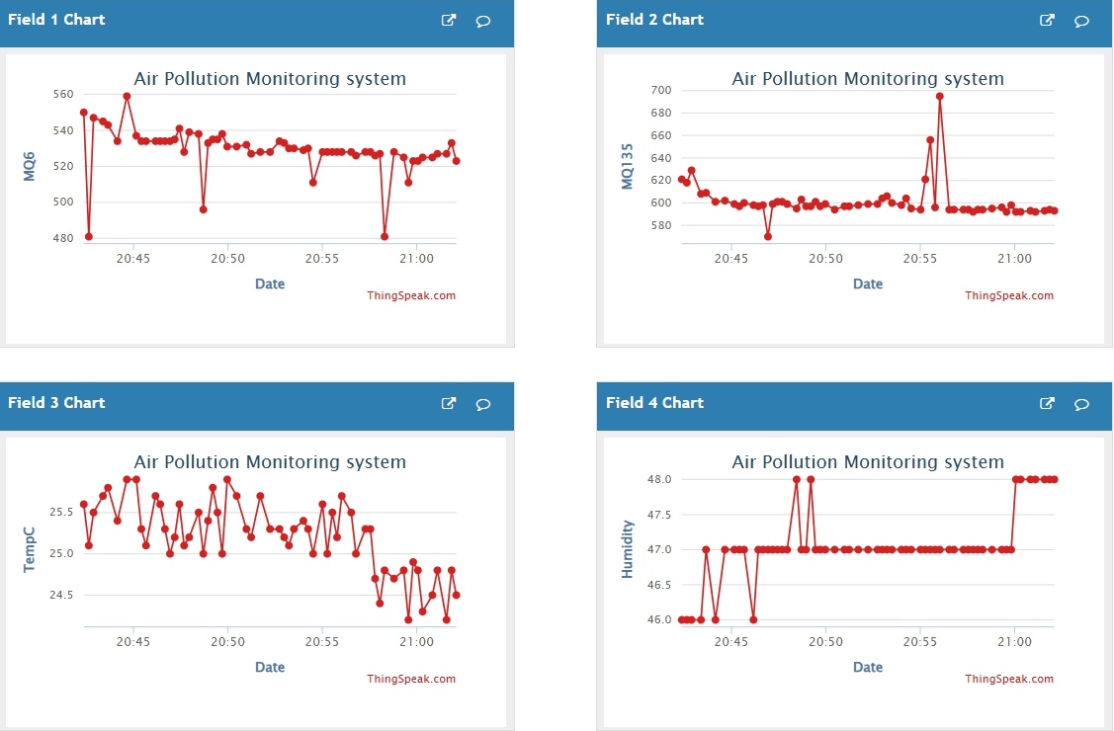

Slide 17
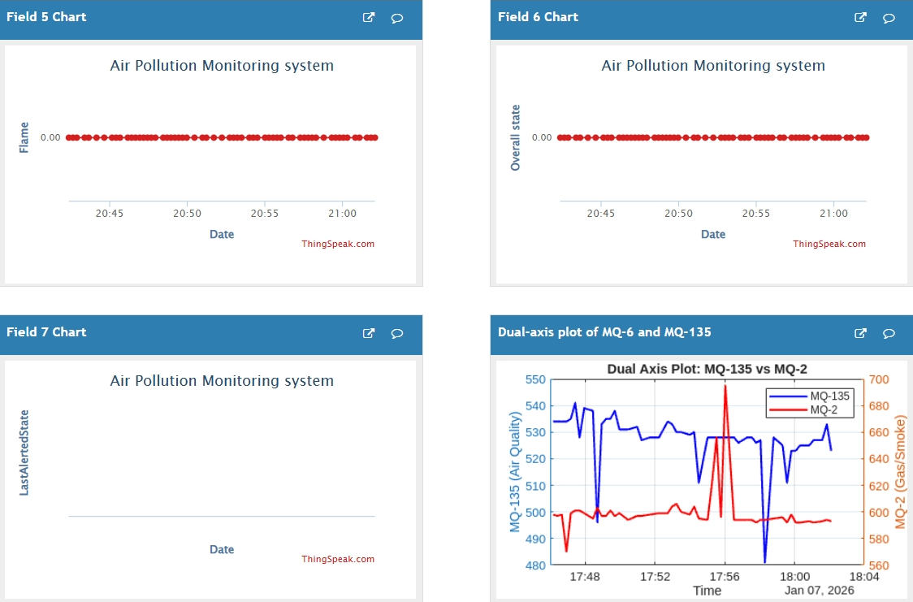

Slide 18
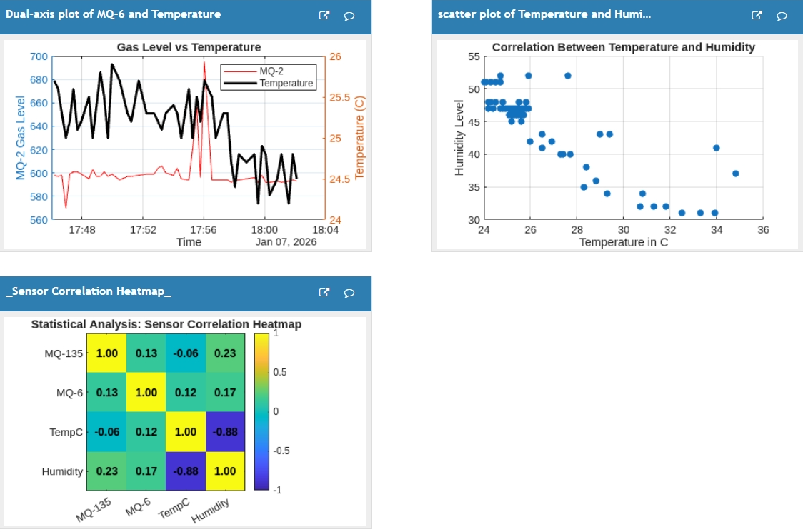

Slide 19
Real-World Applications
Smart Homes
Industrial Safety
Remote safety monitoring.
Immediate reporting of toxic gas leaks
Warehouses
Protecting goods from fire when no one is around.

Slide 20
Thank You

